Slide 1
Project 2
Observations on Wine sample Prediction Dataset
Dushyant Pratap Singh
dushyant.singh@iitg.ac.in

Slide 2
Observations
1. What is the most frequently occurring wine quality? What is the highest number in and the lowest number in the quantity column?
Quality | No. of samples
5 | 681
6 | 638
7 | 199
4 | 53
8 | 18
3 | 10
Wine with quality index 5 has occurred most frequently in this dataset with 681 samples
Wine with quality index 3 has occurred least in this dataset with only 10 samples

Slide 3
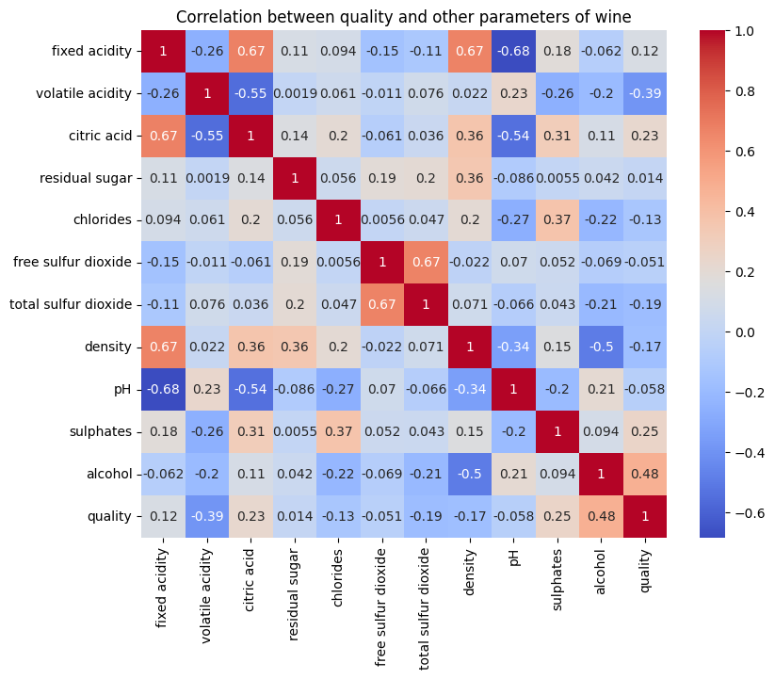
2. How is `fixed acidity` correlated to the quality of the wine? How does the alcohol content affect the quality? How is the `free Sulphur dioxide` content correlated to the quality of the wine?
Feature | Correlation with Quality
Fixed Acidity | 0.1241
Alcohol Content | 0.4762
Free Sulfur Dioxide | -0.0507

Slide 4
Alcohol content has the strongest positive correlation with wine quality
With a correlation coefficient of +0.4762, alcohol content significantly influences perceived wine quality. This suggests that higher alcohol levels are generally associated with better quality wines in this dataset
Fixed acidity shows a weak positive correlation
The correlation between fixed acidity and quality is +0.1241, indicating a minor positive effect. While not strong, it implies that wines with slightly higher fixed acidity tend to be rated better, though the relationship is not robust.
Free Sulphur dioxide is weakly negatively correlated with quality
A correlation of -0.0507 means that higher levels of free Sulphur dioxide may slightly reduce the perceived quality of wine, possibly due to its impact on aroma or taste. However, the effect is negligible and may not be statistically significant.

Slide 5
3. What is the average `residual sugar` for the best quality wine and the lowest quality wine in the dataset?
Average residual sugar for best quality wine (5) is 2.528854625550661 Average residual sugar for worst quality wine (3) is 2.6350000000000002
4. Does `volatile acidity` has an effect over the quality of the wine samples in the dataset?
Correlation: -0.3906
Pattern Analysis:
Quality 3: Average volatile acidity = 0.8845
Quality 4: Average volatile acidity = 0.6940
Quality 5: Average volatile acidity = 0.5770
Quality 6: Average volatile acidity = 0.4975
Quality 7: Average volatile acidity = 0.4039
Quality 8: Average volatile acidity = 0.4233
CONCLUSION:
YES - Volatile acidity negatively affects wine quality
Evidence: Strong correlation (-0.3906) and clear trend in mean

Slide 6
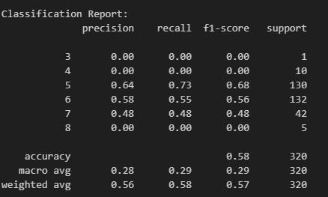
5. Train a Decision Tree model and Random Forest Model separately to predict the Quality of the given samples of wine. Compare the Accuracy scores for both models.
Decision tree observations:
Applying GridSearchCV for hyper parameter tuning gives the best hyper parameters as
Best cross-validation-score : 0.6052113970588235
Training Accuracy: 0.6559812353401094
Test Accuracy: 0.584375
Hyper parameter | Value
Criteria | Entropy
Max_depth | 5
Min_samples_leaf | 4
Min_samples_split | 2

Slide 7
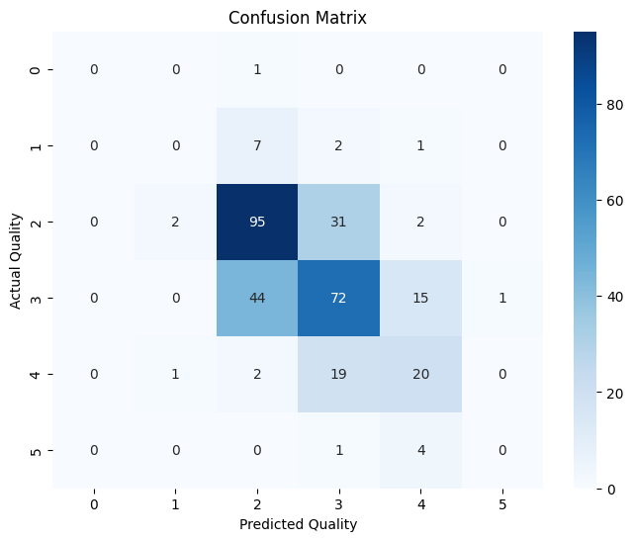
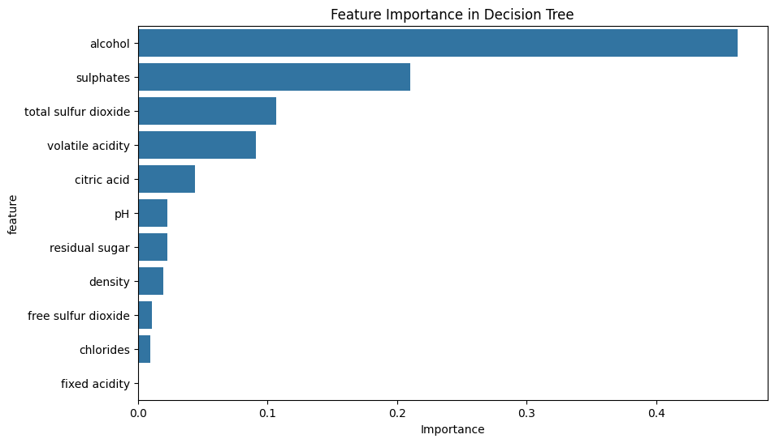
Confusion Matrix for Decision Tree
Alcohol is the most important feature for decision tree classifier, which means splitting of first node of the decision tree would be based on alcohol followed by sulphates and then other important features for the further splitting.

Slide 8
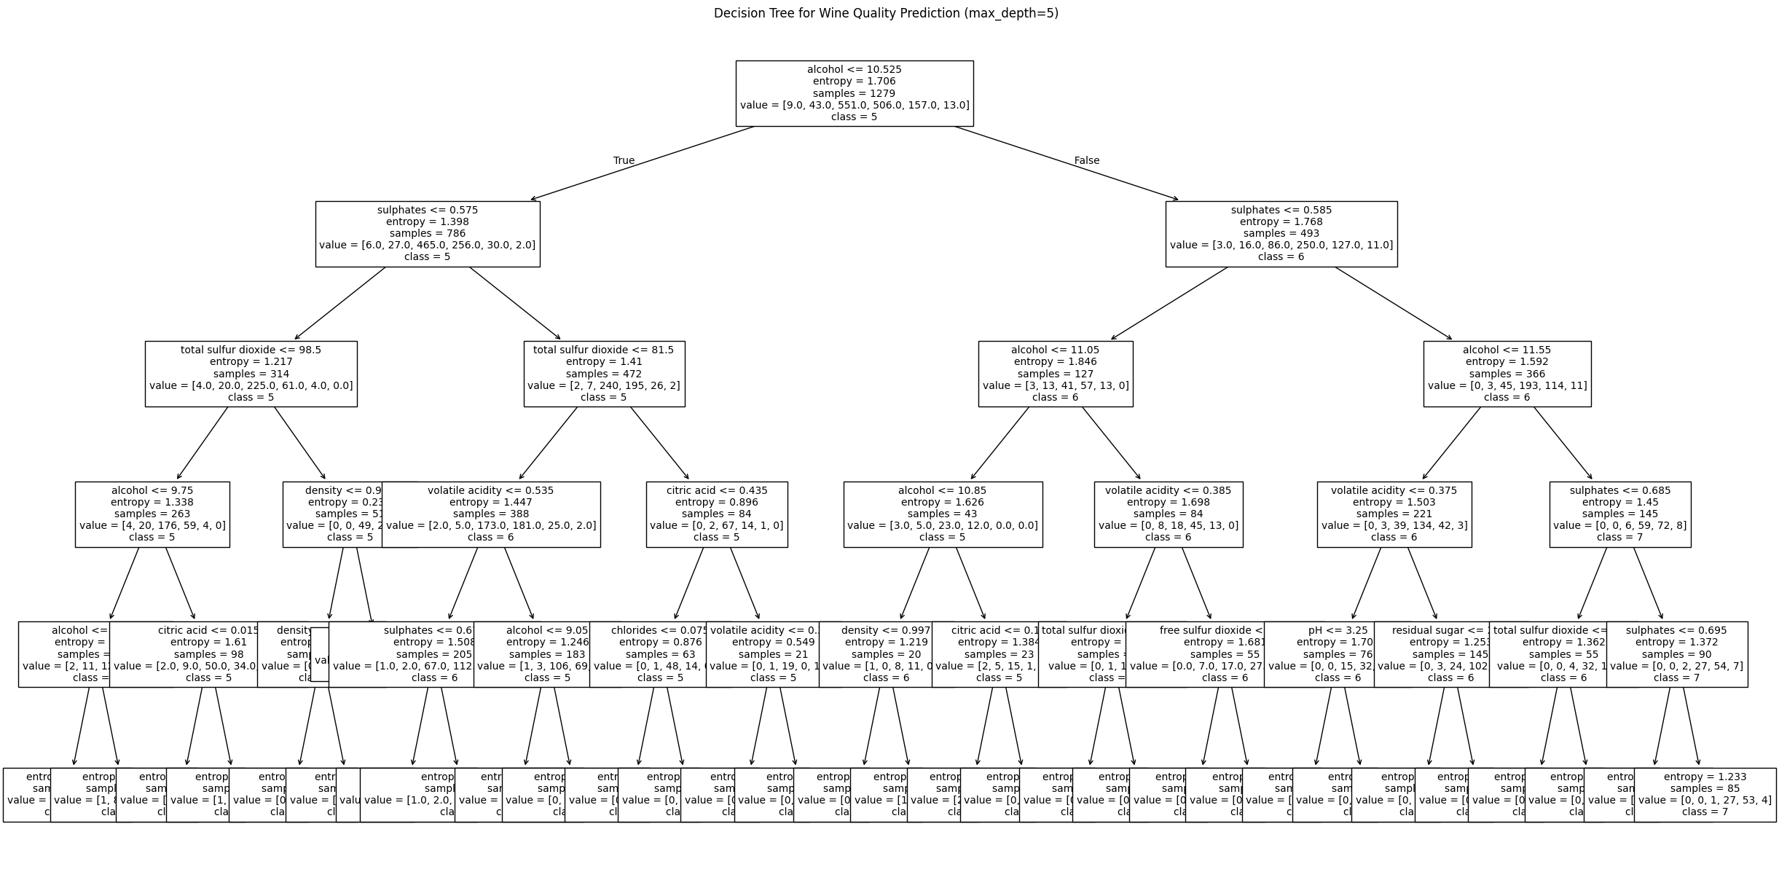

Slide 9
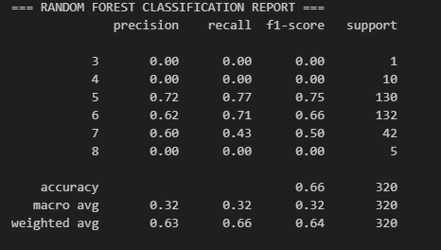
Random Forest observations (Grid search CV)
Applying GridSearchCV for hyper parameter tuning gives the best hyper parameters as
Best cross-validation-score: 0.6919791666666667
Random Forest Training accuracy : 0.9765441751368257
Random Forest test accuracy : 0.6625
Hyper parameter | Value
Bootstrap | True
Max_depth | None
Max_featues | Sqrt
Min_samples_leaf | 2
Min_samples_split | 2
N_estimators | 300

Slide 10
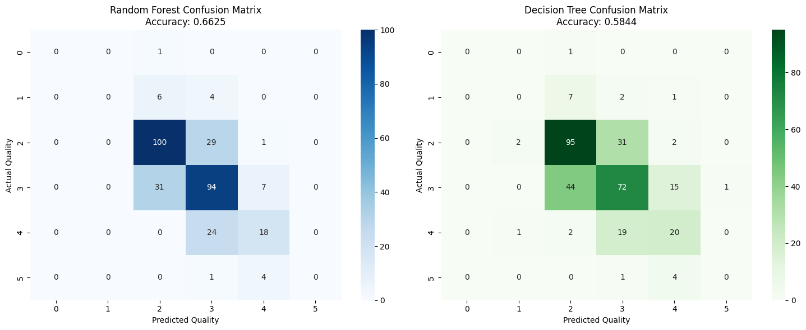
Comparison between Random Forest and Decision Tree Confusion Matrix

Slide 11
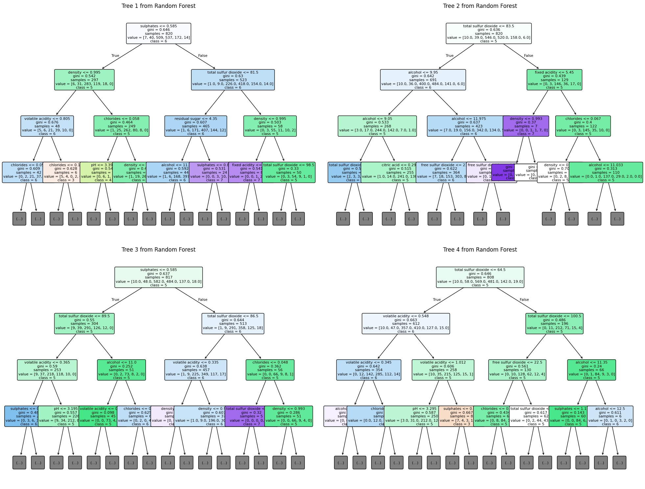

Slide 12
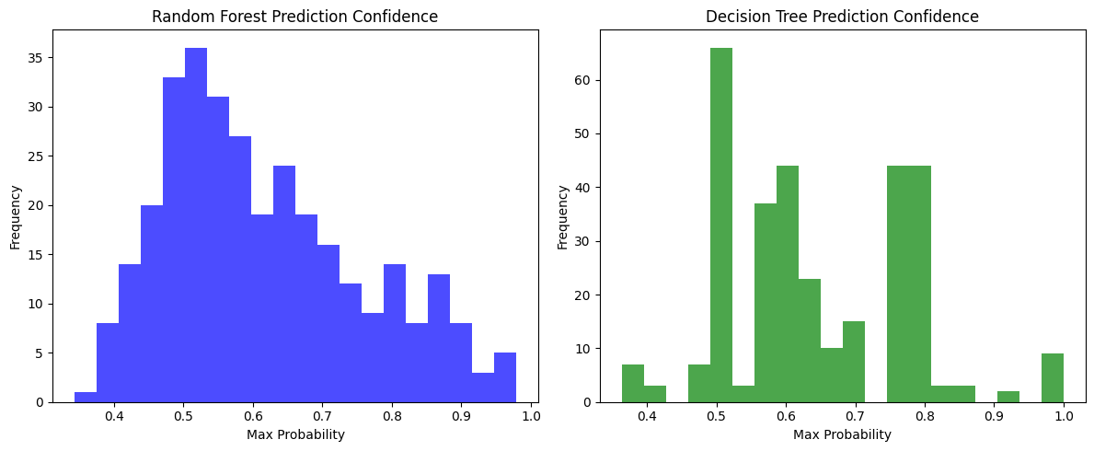
Model Confidence Analysis
Random Forest average confidence: 0.6152 Decision Tree average confidence: 0.6441
Decision Tree shows higher average confidence than Random Forest
Random Forest predictions are more probabilistically distributed
Decision Tree predictions are highly concentrated around specific confidence levels

Slide 13
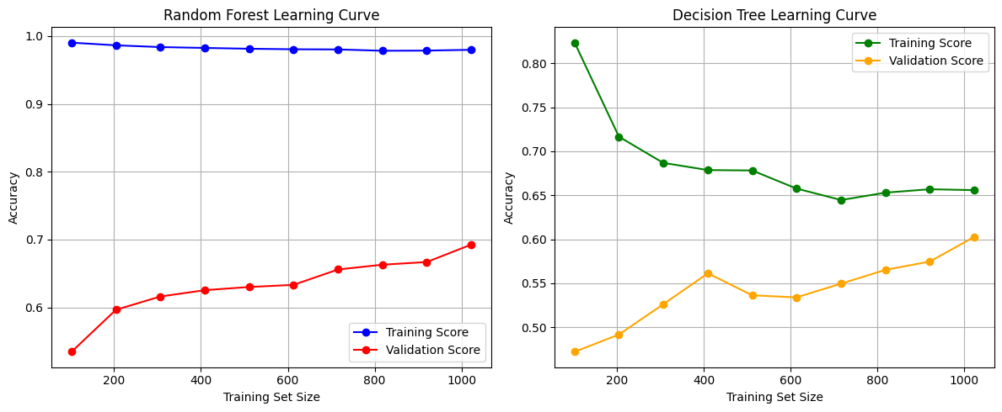
Learning Curve Comparison
Random Forest Learning Curve
High training accuracy, lower validation accuracy → Overfitting
Validation accuracy improves with more data
Decision Tree Learning Curve
Significant overfitting with small data
More balanced learning at larger sizes

Slide 14
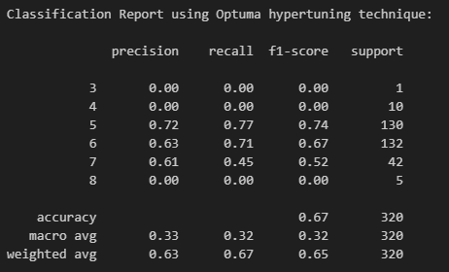
Random Forest observations (Optuna hypertuning technique)
Applying Optuna technique for hyper parameter tuning gives the best hyper parameters as
Hyper parameter | Values
N_estimators | 349
Max_depth | 16
Min_samples_split | 2
Min_samples_leaf | 2
Max_features | Log2
Bootstrap | True
Best trial accuracy: 0.6935508578431373
Train Accuracy with best hyperparameters: 0.97967
Test Accuracy with best hyperparameters: 0.665625

Slide 15
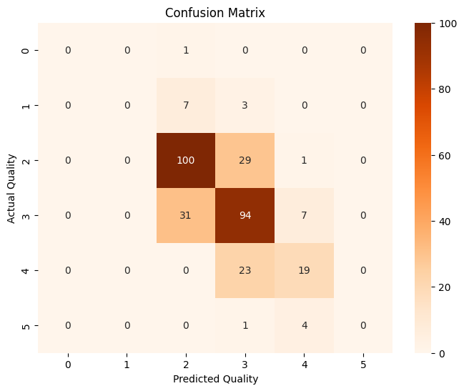
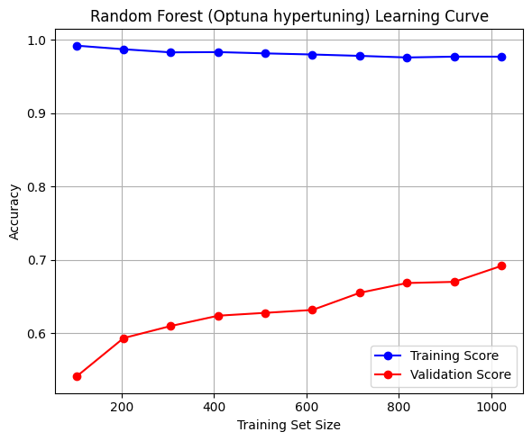
Confusion Matrix for Random Forest using Optuna Hypertuning Technique
Learning rate for Random Forest using Optuna hypertuning technique is similar to that of with Grid search CV

Slide 16
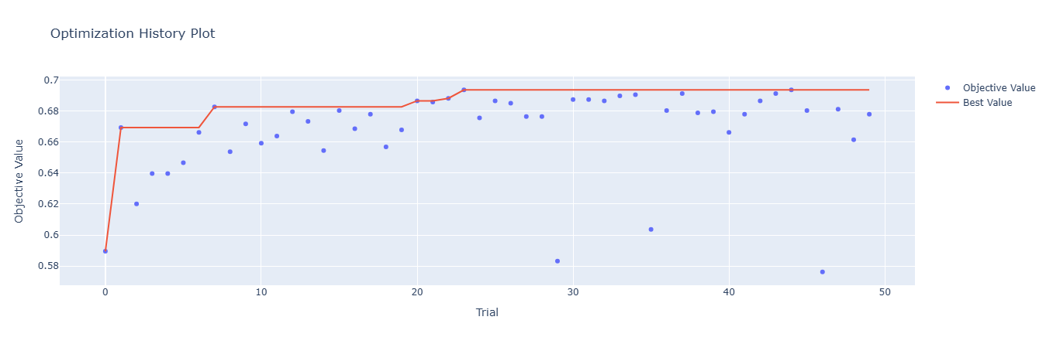
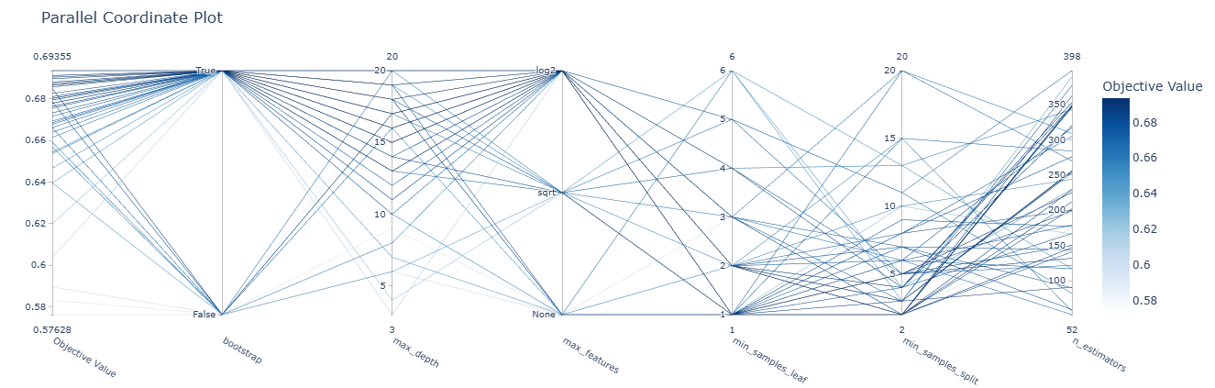
Optuna Visualization Plots
1. Optimization History Plot
2. Parallel Coordinate Plot

Slide 17
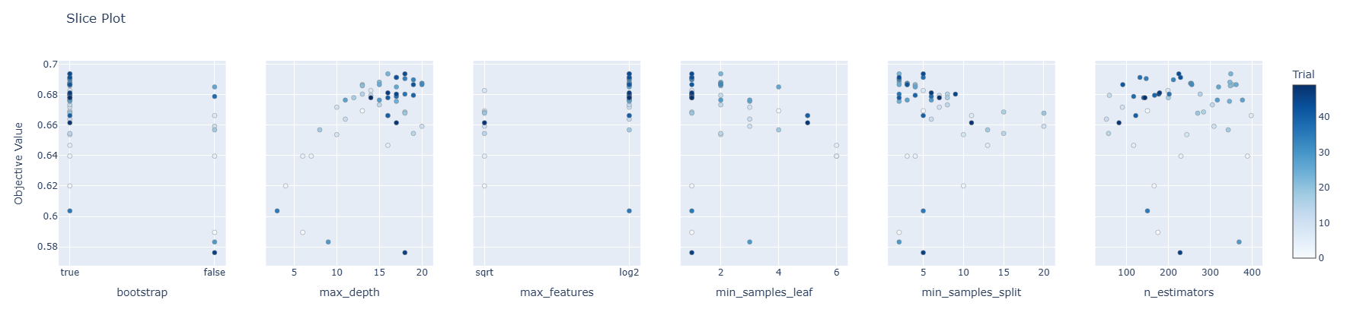
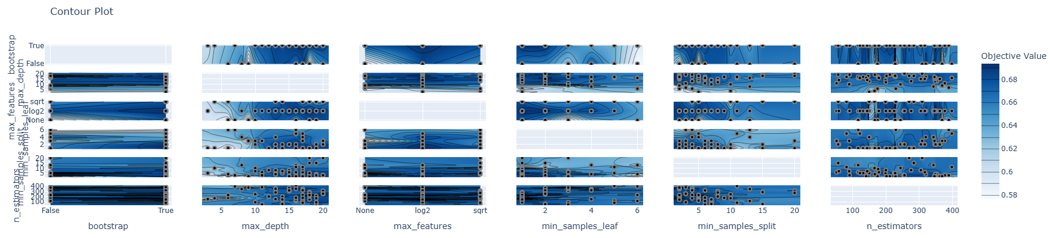
3. Slice Plot
4. Contour Plot

Slide 18
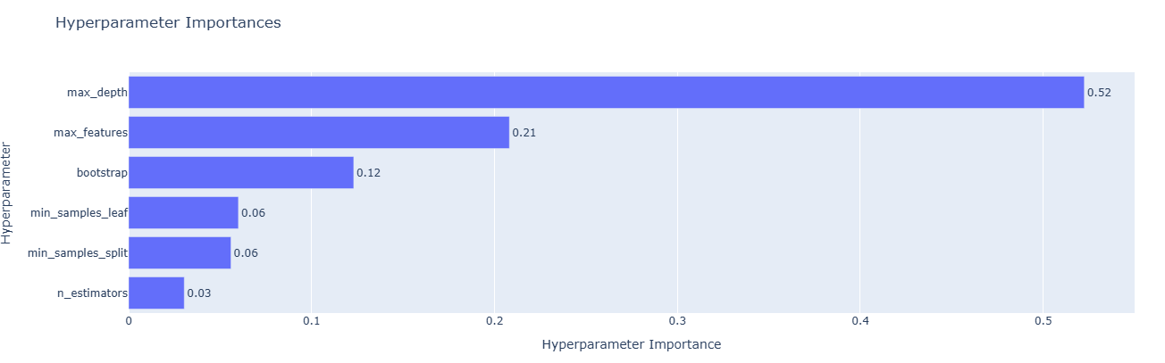
5. Hyperparameter Importances

Slide 19
==============================================================================================
FINAL MODEL COMPARISON SUMMARY
==============================================================================================
Decision Tree:
Test Accuracy: 0.5844
Max Depth: 5
Interpretability: High (single tree)
Training Time: Fast
Random Forest using grid search cv:
Test Accuracy: 0.6625
Number of Trees: 300
Max Depth: None
Interpretability: Lower (ensemble)
Training Time: Slower
Random Forest using optuna hyper tuning technique:
Test Accuracy: 0.6656
Number of Trees: 349
Max Depth: 16
Interpretability: Lower (ensemble)
Training Time: Slower
Recommendation:
Use Random Forest with optuna hyper tuning technique - Significantly better accuracy

Slide 20
Thank you

